Slide 1

CPS Town Hall Series
December 10, 2020
Guest: Colorado State Board of Pharmacy
Moderator: Emily Zadvorny, Executive Director, CPS

Slide 2
CPS Town Hall - Housekeeping Items
Keep yourself muted, or we will ☺
Put your settings in Zoom on “Speaker View” to better visualize our guest speaker(s).
If you have a question you can put it in the “chat box”. Please indicate if you’d like to be unmuted to ask the question yourself! Otherwise the moderator will ask the questions for you.
No CE, thanks for registering so we can appreciate our attending audience
Please join CPS if you aren’t a member: www.Copharm.org
These will be recorded for future viewing or sharing

Slide 3


Colorado Pharmacists Society / State Board of Pharmacy
Town Hall
December 10, 2020

Slide 4

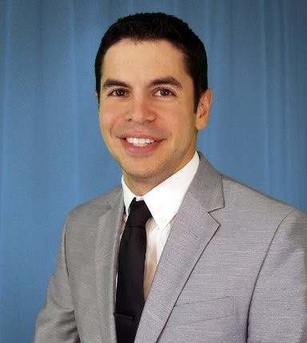

DORA / PDMP / Board of Pharmacy Presenters
Nathan Batchelder
Director
External Affairs
Dmitry
Kunin
Program Director, BOP (PharmD, MBA)
Mark
O’Neill
Inspector, BOP
(RPH, B.S.)

Slide 5

DORA / BOP Structure
Division of Professions
and Occupations
Other DORA Divisions
Real Estate
Civil Rights
Banking
Financial Services
Securities
Insurance
Consumer Counsel
Conservation
COPRRR
Public Utilities
Licensure and enforcement of 50+ professions,
occupations and businesses, including State Board of Pharmacy
Regulates approximately 450,000 people or
15% of Colorado’s workforce

Slide 6
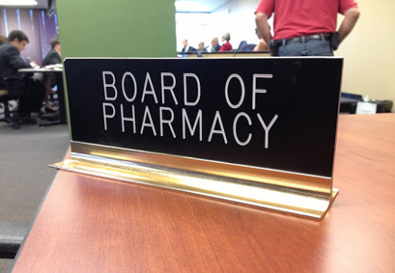
Composition
5 Professionals / 2 Public
Appointed by Governor
4-Year Term (Max 2)
Applicants Wanted

Slide 7
Legislative Process
Legislative Session Occurs
Bills Emerge
Once signed, if language clean, becomes part of Practice Act
If Bill requires rulemaking, Board goes through implementing via rule
Difference Between Statute and Rule

Slide 8
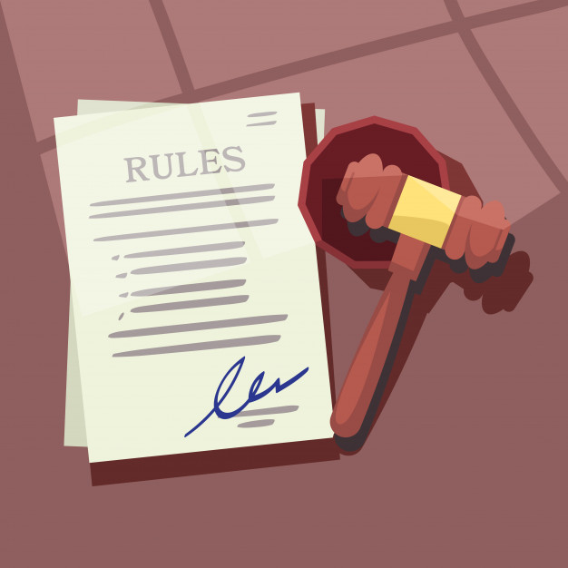
Board Actions
Most Recent Example of Rulemaking
> Nov. 19: Emergency Rulemaking to allow Pharmacy Techs to administer vaccinations
> Dec. 11: Stakeholder Feedback for Pharmacy Tech rule changes
> Required rulemaking for bill implementation
> Rulemaking out of necessity
> Rulemaking from Board member perspective
2020 at a glance

Slide 9





What Does the Board Review?
BOP
Meeting Logistics
Consumer Protection Role
Complaint Driven Process
Determining Disclipline

Slide 10


More Board Responsibilities
OFFICE OF INVESTIGATION
Board of Pharmacy Inspectors’ Role
LICENSING
2019 Pharmacy Technician Bill

Slide 11

General Inspection Process
Who do we inspect?
How often do we inspect
Who do we work for?
General overview of what we are inspecting
What happens when deficiencies are found
How inspectors are used by the Board in processing complaints

Slide 12

Prescription Drug Monitoring Program
PDMP: What is it?
Where does it get its data and how often?
What’s the underlying purpose?
Unlawful use and implications
Delegated access
Integration into HIE/HER

Slide 13
QUESTIONS?

