Slide 1
COVID-19: Implications for Pharmacists
Paul Reynolds, PharmD, BCCCP
Matthew Miller, PharmD, BCIDP
Gina Moore, PharmD, MBA
March 20, 2020

Slide 2
Learning Objectives
Identify the unique clinical and epidemiological characteristics of Coronavirus (COVID-19) in the spectrum of viral clinical illnesses and previous Coronavirus (SARS, MERS) and non-Coronavirus (influenza, common cold) related illnesses
Describe the epidemiological impact of interventions to reduce spread of disease in the setting of limited healthcare resources
Summarize common clinical presentations of COVID-19 compared to other cold and influenza related illnesses and describe who should receiving referral for testing
Analyze emerging literature regarding potential treatment modalities for COVID-19
Devise potential roles for pharmacists and technicians in a variety of healthcare settings for the management of a COVID-19 pandemic
List the steps the Colorado Pharmacists Society (CPS) is taking to address COVID-19.
Describe how CPS is collaborating with other professional pharmacy organizations and state and federal agencies.

Slide 3
Before Our Talk…
Information regarding COVID-19 is rapidly evolving
Quality of data in a pandemic is limited (especially early)
Case Series
Case Reports
Important to separate preliminary information from fact
Experimental conditions vs real world data
Efficacy of antivirals vs clinical efficacy
Pharmacist’s role:
Trusted
Source of truth
Separate science from theory and opinion

Slide 4
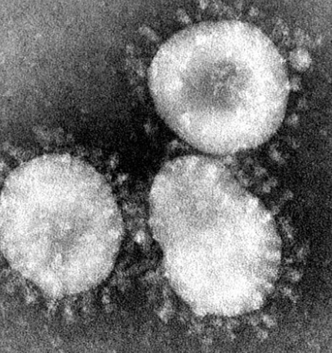
Introduction and Nomenclature
Coronavirus as a Family of Viruses
Positive sense RNA viruses
Largest genome of RNA viruses
Beta-Coronaviruses most common to infect humans
HCoV variants – the common cold (infecting humans for 800 plus years)
Mutant variants – SARS-CoV, MERS, SARS-CoV-2/COVID19
COVID-2019
Also known as “coronavirus” or SARS-CoV-2
Origination in China (patient zero likely November or December 2019)
76% identical genome to SARS
96% identical genome to Cave Bat CoV

Slide 5
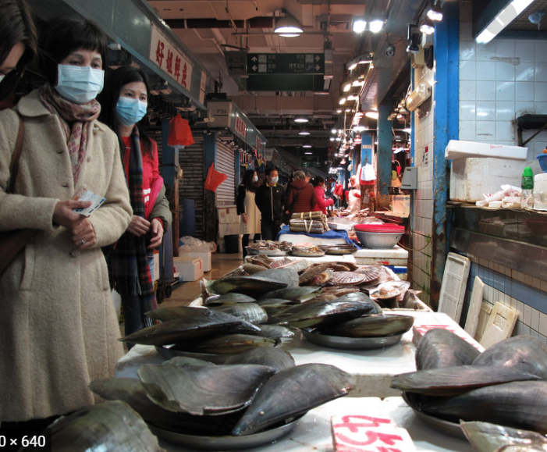
Original Mode of Transmission
Pathogens 2020, 9, 186; doi:10.3390/pathogens9030186

Slide 6
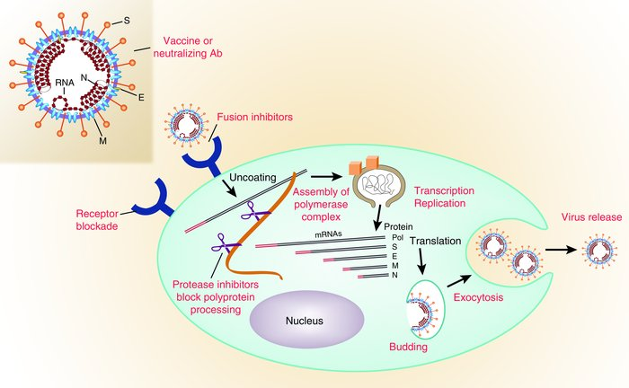
Entry Proteins
ACE2 (SARS and COVID)
DPP4 (MERS)
Chloroquine
Hydroxychloroquine
Remdesivir
+/- favipiravir
Lopinavir/ritonavir
? Nitazoxanide
J Clin Invest. 2003;111(11):1605-1609.
Cell Res. 2020 Mar; 30(3): 269–271.

Slide 7
COVID-19 Myth 1: ACE/ARB Treated Patients Do Worse Because of Viral Entry ACE Protein
Answer:
Could Happen But No Data
ACC/HFSA/ESC say do not discontinue to prevent COVID-19
Few differences in# hypertensive patients with mild vs severe disease
Image source amazon

Slide 8
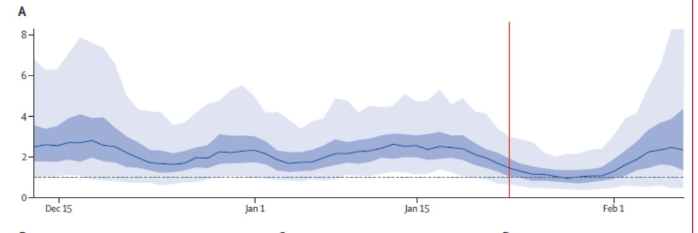
Why Is COVID-19 So Clinically Relevant?
COVID-19 Has a Basic Reproduction (Ro) number of 2-3
Virus | Ro
Influenza (H1N1) | 1.3
1918 Influenza Pandemic | 2-3
Smallpox | 5-7
Ebola | 1.5-2.5
Journal of Travel Medicine, 2020, 1–4

Slide 9
COVID-19 Myth 2: COVID-19 Can Live on Surfaces for Days
Answer 2:
Droplets are primary mode of transmission
(Aerosol Half Life – 1 hour)
Asymptomatic patients with a high viral load can transmit (2 days before symptoms)
Answer 1: Partially False
Determined by Inoculum Size and Half Life on Object
Steel: 5.6 hours
Plastic: 6.8 hours
Very low inoculum at 72 hours but still there (same as SARS)
Image source amazon
Data source: https://www.nejm.org/doi/full/10.1056/NEJMc2004973

Slide 10
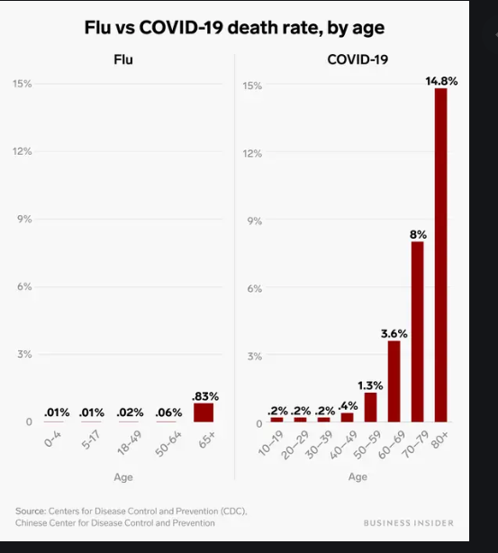
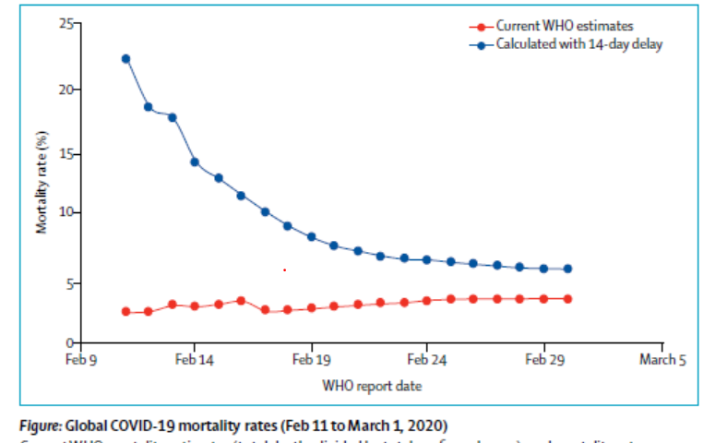
Why Is COVID-19 So Clinically Relevant?
Source: CDC
Source: Baud et al Lancet Infectious disease 2020

Slide 11
Source: https://special.croi.capitalreach.com/

Slide 12
Differentiating Symptoms
Symptom/Lab | COVID-19 | Influenza | Common Cold
Fever | >80-90% – careful sometimes delayed! | >80-90% | Very Rare
Cough | 70% of which majority is dry cough (30% sputum producing) | Often dry | Common – dry or wet
Myalgia/Fatigue | 11-50% | Common | Rare
Immune effects | Leukopenia (30-60%) – T cell Depression | Rare | Never
Platelet effects | Thrombocytopenia (40-60%) | Rare | Never
Sneezing | No | Rare | Common
Congestion | No | Rare | Common
Sore Throat | 13% | Rare | Common
Hospitalization Rate | 4-16% (ICU) | 0.03% | Rare
Cause of Death | Acute Respiratory Distress Syndrome (ARDS) | ARDS | Rare

Slide 13
Testing for COVID-19
What tests are available?
Standard of care: Real time rRT-PCR (Nasopharyngeal, oropharyngeal, bronchioalveolar lavage, aspirates, sputum)
Alternative testing (in development): IgM ELISA, Point of care testing
Who to test?
At risk individuals with symptoms compatible with COVID-19
Hospitalized patients with symptoms compatible with COVID-19
Any persons (esp healthcare workers) within 14 days of close contact (from sx onset) of a confirmed COVID-19 patient
Colorado: Mitigation strategies may go into effect

Slide 14
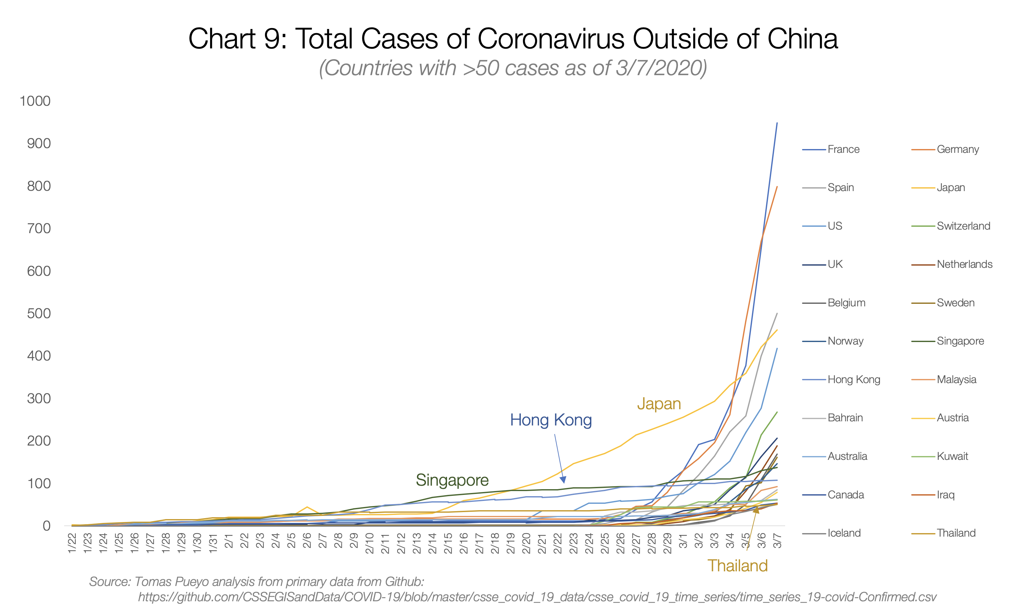
The Reason for Separation
Source: Medium.com

Slide 15
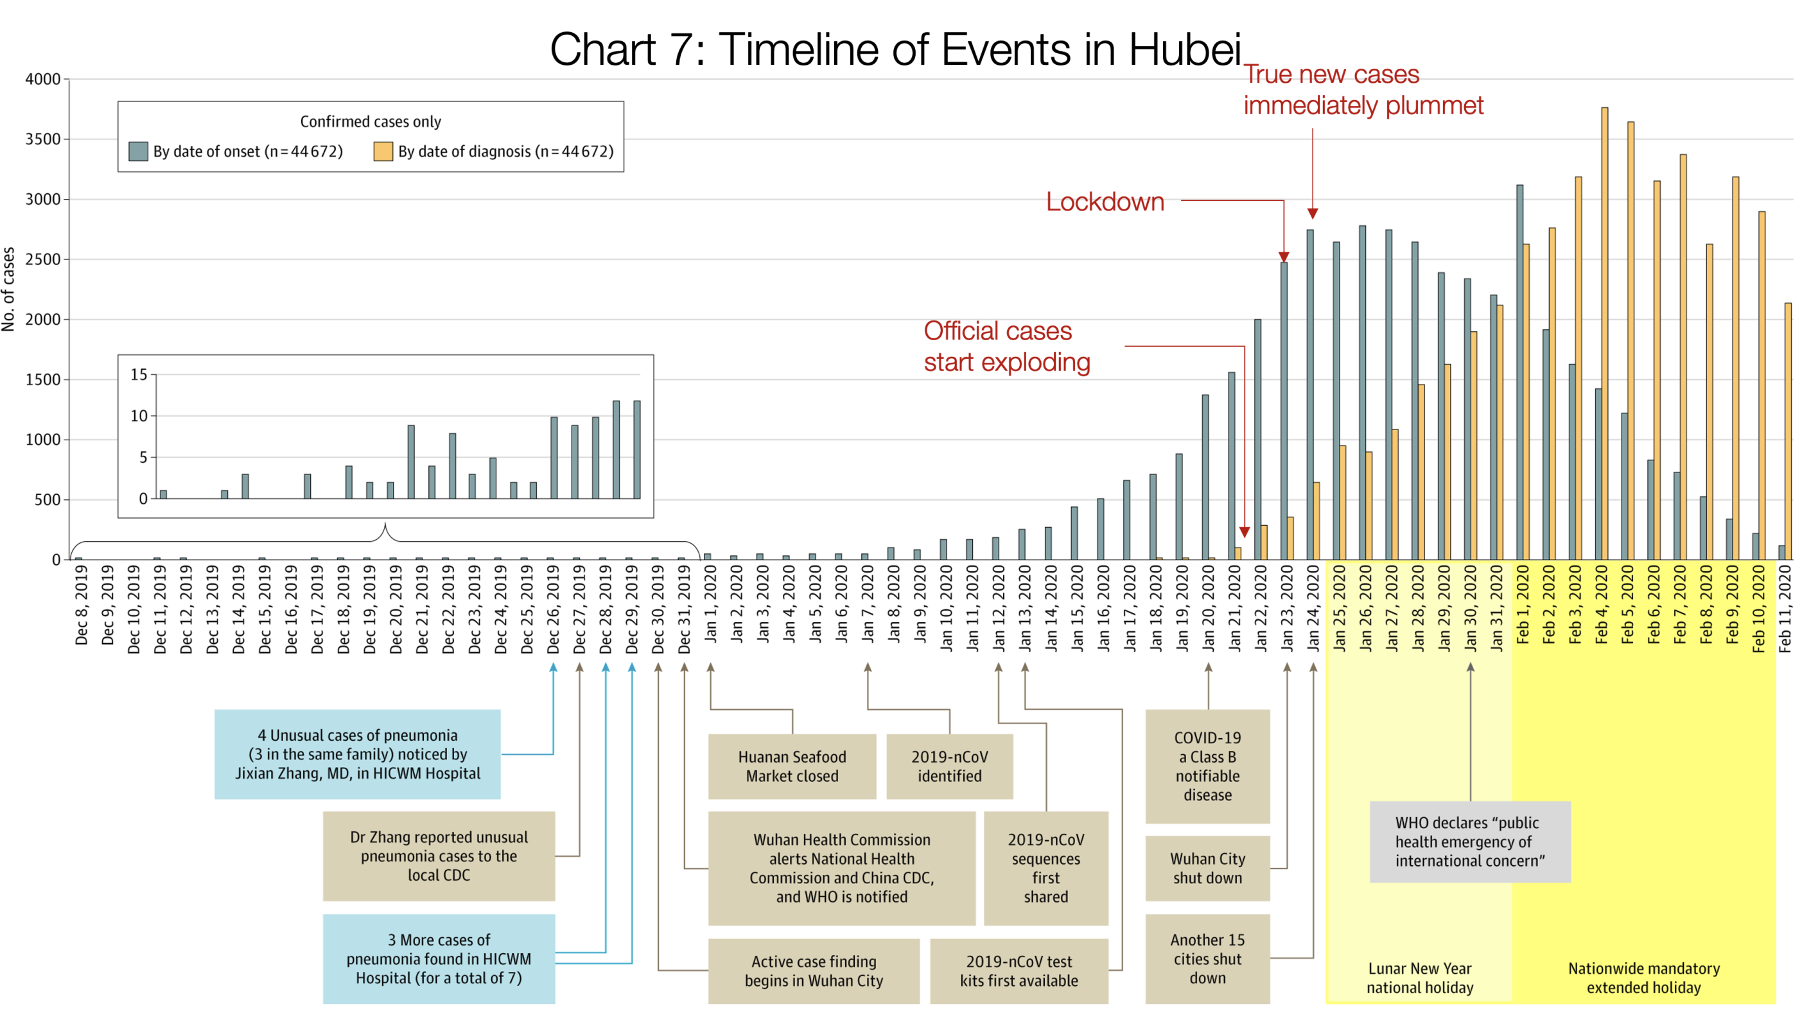
Source: JAMA

Slide 17
Compliance and spread
No Distancing
50% Distancing
USA Has:
-95,000 ICU beds (68,000 adult)
-62,000 ventilators (60% of which for adults) – may be able to get to 200,000 with old ventilators and emergency supplies
(130,000 to staff)
-If unchecked: 900,000 will require ventilation
https://towardsdatascience.com/social-distancing-to-slow-the-coronavirus-768292f04296
Source: https://sccm.org/Blog/March-2020/United-States-Resource-Availability-for-COVID-19

Slide 18
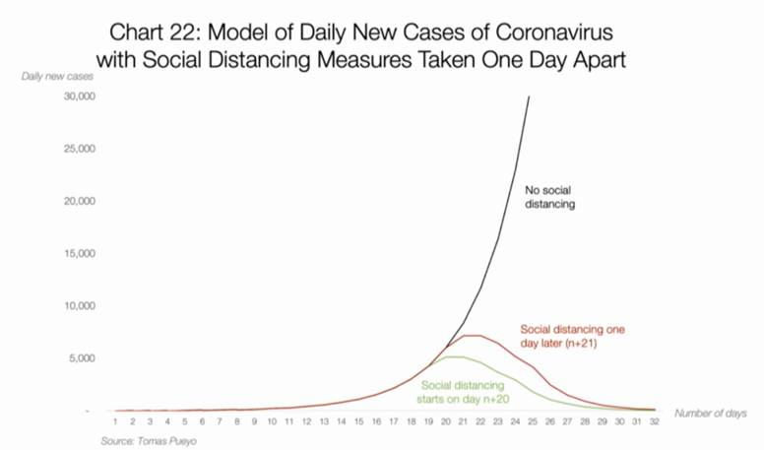
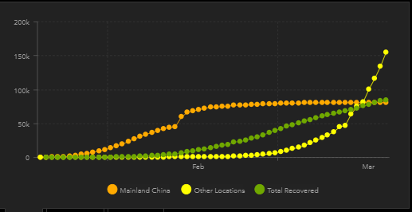
Compliance and Spread
USA is Here

Slide 19
Therapeutics for COVID-19
No antiviral therapy has proven effects against COVID-19, and none of the following agents have any approved indications for COVID-19

Slide 20
Chloroquine
Hydroxychloroquine
Remdesivir
+/- favipiravir
Lopinavir/ritonavir
? Nitazoxanide
J Clin Invest. 2003;111(11):1605-1609.
Cell Res. 2020 Mar; 30(3): 269–271.

Slide 21
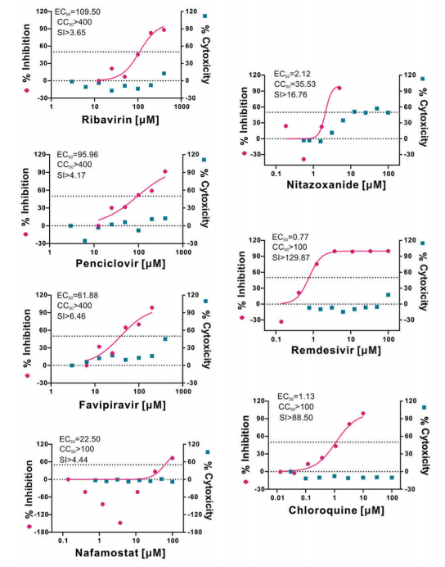
In Vitro Activity
SARS-CoV-2 EC₅₀ lowest for:
Remdesivir (Gilead) – investigational, broadly active against RNA viruses
Chloroquine – FDA approved anti-malarial agent
CID. 2020: Hydroxychloroquine EC₅₀ = 0.72 μM vs. chloroquine EC₅₀ = 5.5 μM
Nitazoxanide – FDA approved anti-parasitic with reported anti-viral effects
Lopinavir/ritonavir
SARS-CoV-1: EC₅₀ = 17 μM
EC₅₀ down to 1 μg/mL if ribavirin added
HIV EC₅₀ = 0.017-0.102 μM
Cell Res, 2020; 30 (3), 269-271. Clin Infect Dis. 2020; Epub (PMID: 32150618)
Antimicrob Agents Chemother. 2014; 58(8): 4875-84.

Slide 22
Clinical Evidence – Chloroquine/hydroxychloroquine
In vitro data only published
Hydroxychloroquine 400mg PO BID x 1 day, then 200mg PO BID x 4 days
Chloroquine 500mg PO BID x 5 days
No published clinical experience to date
Reports from China (not actual data presented/published)
Reduces pneumonia exacerbation
Reduces duration of symptoms
Improves viral clearance
Well-tolerated
Monitoring – QTc prolongation, GI side effects, retinopathy
Clin Infect Dis. 2020; Epub (PMID: 32150618)
Biosci Trends. 2020; 14(1): 72-3.

Slide 23
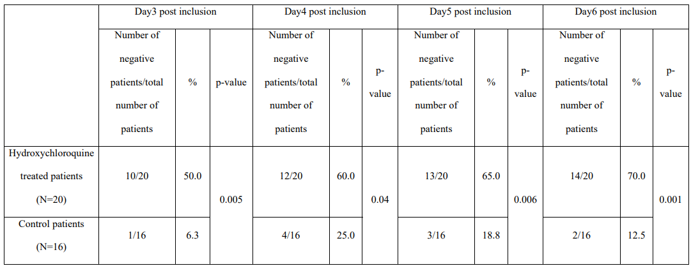
Clinical Evidence – Hydroxychloroquine
Prospective, non-randomized, open-label study
Hospitalized with confirmed COVID-19
All patients offered hydroxychloroquine (HCQ) 200mg PO TID
Those refusing treatment or who met exclusion (allergic to HCQ, retinopathy, QT prolongation, G6PD deficiency) served as untreated controls
Antibiotics could be given for treatment/prevention of bacterial infection
Primary endpoint = virologic clearance at day 6
Gautret et al. (2020) Hydroxychloroquine and azithromycin as a treatment of COVID‐19: results of an open‐label non‐randomized clinical trial. International Journal of Antimicrobial Agents – In Press 17 March 2020 – DOI : 10.1016/j.ijantimicag.2020.105949

Slide 24
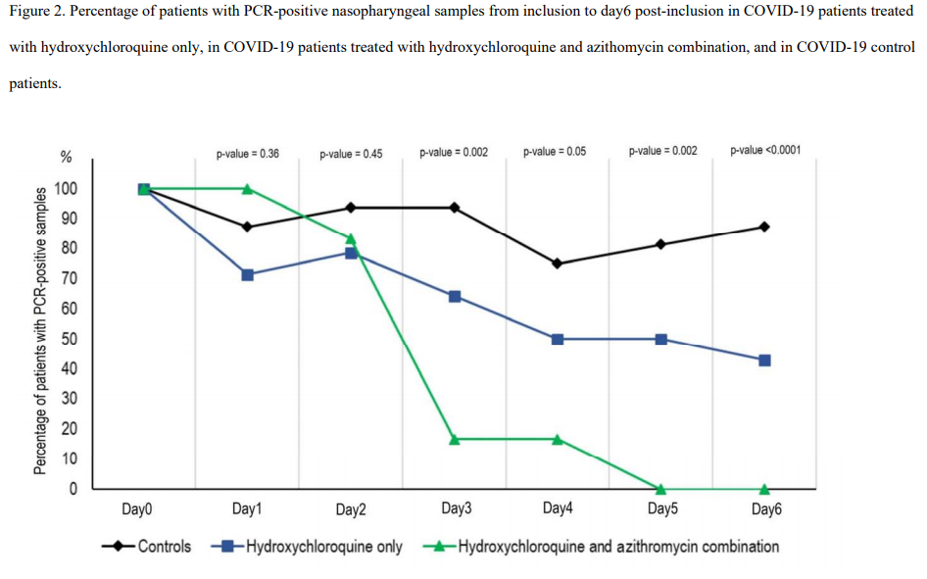
Clinical Evidence – Hydroxychloroquine
Results excluded 6 HCQ treated patients
3 ICU transfers
1 died
1 left hospital
1 stopped HCQ for GI upset
Limited data for clinical outcomes
Unclear role of azithromycin
Gautret et al. (2020) Hydroxychloroquine and azithromycin as a treatment of COVID‐19: results of an open‐label non‐randomized clinical trial. International Journal of Antimicrobial Agents – In Press 17 March 2020 – DOI : 10.1016/j.ijantimicag.2020.105949

Slide 25
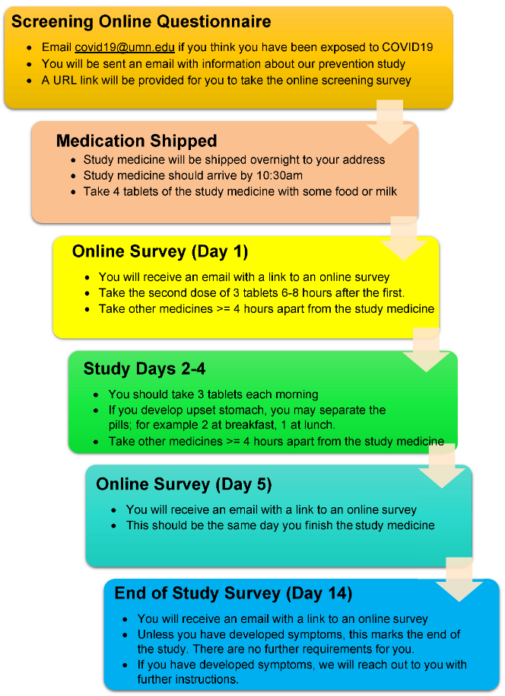
Clinical Evidence – Hydroxychloroquine
Post-exposure prophylaxis study - HCWs:

Slide 26
Clinical Evidence – Lopinavir/ritonavir
SARS-CoV-1
Chu et al. 2004: ARDS or death lower with lopinavir/ritonavir vs. ribavirin alone (2.4% vs. 29%)
Retrospective, imbalance in baseline characteristics between groups, lopinavir/ritonavir patients received concomitant ribavirin
Rapid viral load decline in lopinavir/ritonavir recipients from nasopharyngeal specimens
Chan et al. 2003: lopinavir/ritonavir plus ribavirin decreased mortality compared to ribavirin alone (2.3% vs. 11%, p < 0.05)
Matched, retrospective study. All patients received concomitant corticosteroids as well
Rescue therapy with lopinavir/ritonavir not different from matched controls
Park et al. 2019: lopinavir/ritonavir plus ribavirin effective as post-exposure prophylaxis against MERS-CoV
Thorax 2004;59:252-256. Hong Kong Med J. 2003; 9(6): 399-406 J Hosp Infect. 2019; 101(1): 42-46

Slide 27
Clinical Evidence
Open label RCT, published 3/19/2020
Inclusion: adults with confirmed COVID-19 with radiographic pneumonia and hypoxia (SaO2 < 94% on RA or PaO2:FiO2 < 300
Exclusion: severe liver dysfunction, HIV, pregnancy, significant interactions
Outcomes:
Primary: time to clinical improvement
Secondary: clinical status, 28-day mortality, duration of mechanical ventilation, hospital and virologic measures
N Eng J Med. 2020. Epub: PMID: 32187464

Slide 28
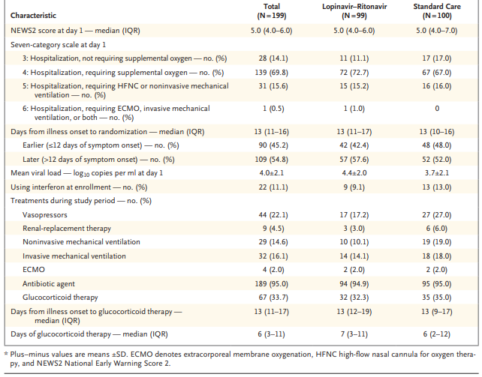
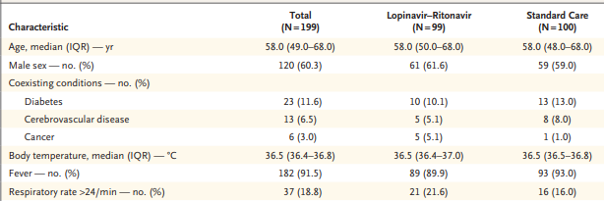
Clinical Evidence
Baseline demographics
N Eng J Med. 2020. Epub: PMID: 32187464

Slide 29
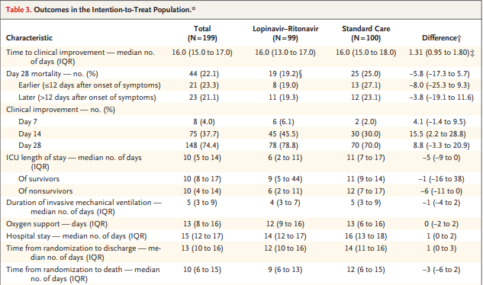
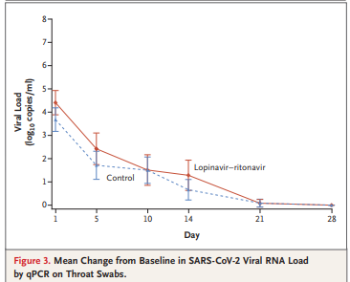
Clinical Evidence
Outcomes:
Lower rate of serious AEs
N Eng J Med. 2020. Epub: PMID: 32187464

Slide 30
Clinical Evidence - Remdesivir
Appears effective against Ebola
Clinical studies lacking for SARS-CoV-2
Ongoing clinical trials
U.S. = 3 studies (1 NIAID and 2 Gilead sponsored)
China = 2 studies
Dosing – 200mg IV load, then 100mg IV daily x 5-10 days
Safety: mostly GI and liver-related effects to date reported
IV contains cyclodextrin (SBECD)
https://clinicaltrials.gov/ct2/results?cond=&term=remdesivir&cntry=&state=&city=&dist=

Slide 31
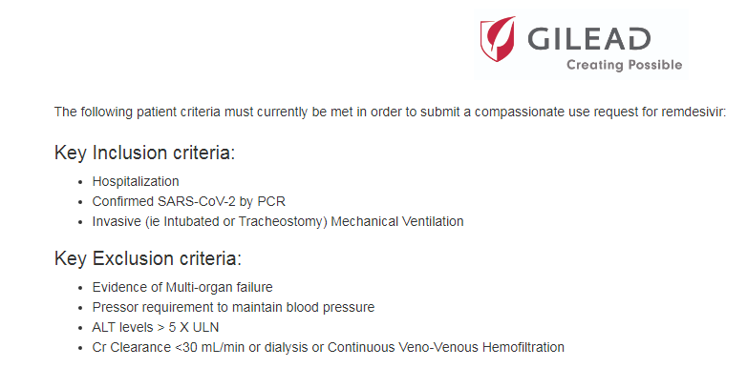
Remdesivir
Compassionate use available (https://rdvcu.gilead.com/)

Slide 32
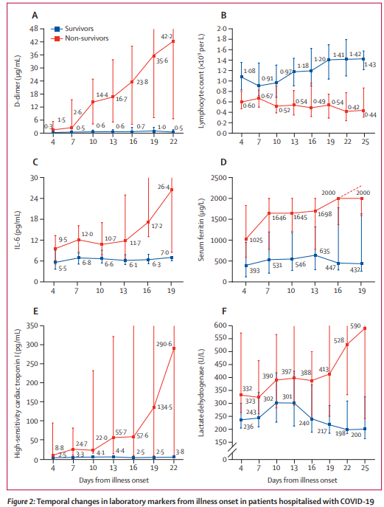
Hyperinflammation
Subset of COVID-19 progress to hyperinflammatory state
High, persistent fever
Cytopenias
Hyperferritinemia
Increased IL-6, CRP, and d-dimer
Screening – Hscore for probability of secondary HLH
Immunosuppression - tocilizumab
Mehta P, et al. Lancet. 2020; epub - DOI:https://doi.org/10.1016/S0140-6736(20)30628-0
Huang C et al. Lancet. 2020; 395: 497-506
Zhou F, et al. Lancet. 2020; epub - DOI: https://doi.org/10.1016/S0140-6736(20)30566-3

Slide 33
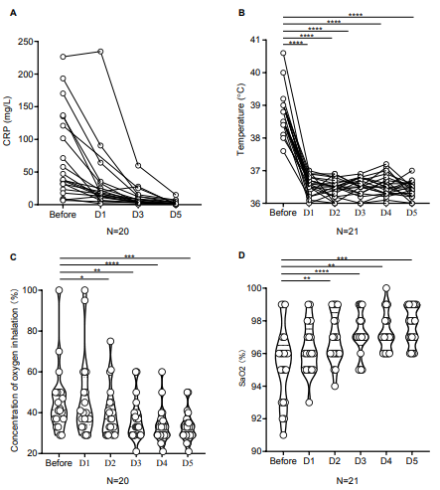
Clinical Evidence – Tocilizumab
Observational study from China, n=21
Standard of care + Tocilizumab 400mg IV single dose
n=3 had repeat dose within 12 hours
Severe (81%) and critical disease (19%) at time of treatment
Severe = RR ≥ 30, SpO2 < 94% on RA, or PaO2:FiO2 ≤ 300
Critical = mechanically ventilated, shock, other organ failure
All 21 survived, 91% discharged
Only 10% were mechanically ventilated
http://www.chinaxiv.org/user/download.htm?id=30387&filetype=pdf

Slide 34
Clinical Evidence - Others
Nitazoxanide – in vitro only to date
Interferon – in vitro and limited clinical experience from SARS-CoV-1 and MERS-CoV (combined with other agents)
Statins – anti-inflammatory mechanism – theoretical presently and no published evidence of direct benefit for COVID-19
IVIG – not expected to be effective, pooled sources unlikely to have any sufficient anti-SARS-CoV-2 neutralizing antibodies
Corticosteroids – unclear role, likely beneficial during later stages of infection where inflammatory response increased
Cell Res, 2020; 30 (3), 269-271.
Antimicrob Agents Chemother. 2020; epub. PMID: 32152082

Slide 35
Tocilizumab and Sarilumab

Slide 36
Clinical Evidence - Others
Nitazoxanide – in vitro only to date
Interferon – in vitro and limited clinical experience from SARS-CoV-1 and MERS-CoV (combined with other agents)
Statins – anti-inflammatory mechanism – theoretical presently and no published evidence of direct benefit for COVID-19
IVIG – not expected to be effective, pooled sources unlikely to have any sufficient anti-SARS-CoV-2 neutralizing antibodies
Corticosteroids – unclear role, likely beneficial during later stages of infection where inflammatory response increased
Cell Res, 2020; 30 (3), 269-271.
Antimicrob Agents Chemother. 2020; epub. PMID: 32152082

Slide 37
Clinical Evidence – Vaccine
Notes:
The vaccine is called mRNA-1273 and was developed by NIAID scientists and their collaborators at the biotechnology company Moderna, Inc., based in Cambridge, Massachusetts. The Coalition for Epidemic Preparedness Innovations (CEPI) supported the manufacturing of the vaccine candidate for the Phase 1 clinical trial.
The investigational vaccine was developed using a genetic platform called mRNA (messenger RNA). The investigational vaccine directs the body’s cells to express a virus protein that it is hoped will elicit a robust immune response. The mRNA-1273 vaccine has shown promise in animal models, and this is the first trial to examine it in humans.
Scientists at NIAID’s Vaccine Research Center (VRC) and Moderna were able to quickly develop mRNA-1273 because of prior studies of related coronaviruses that cause severe acute respiratory syndrome (SARS) and Middle East respiratory syndrome (MERS). Coronaviruses are spherical and have spikes protruding from their surface, giving the particles a crown-like appearance. The spike binds to human cells, allowing the virus to gain entry. VRC and Moderna scientists already were working on an investigational MERS vaccine targeting the spike, which provided a head start for developing a vaccine candidate to protect against COVID-19. Once the genetic information of SARS-CoV-2 became available, the scientists quickly selected a sequence to express the stabilized spike protein of the virus in the existing mRNA platform.
The Phase 1 trial is led by Lisa A. Jackson, M.D., senior investigator at KPWHRI. Study participants will receive two doses of the vaccine via intramuscular injection in the upper arm approximately 28 days apart. Each participant will be assigned to receive a 25 microgram (mcg), 100 mcg or 250 mcg dose at both vaccinations, with 15 people in each dose cohort. The first four participants will receive one injection with the low dose, and the next four participants will receive the 100 mcg dose. Investigators will review safety data before vaccinating the remaining participants in the 25 and 100 mcg dose groups and before participants receive their second vaccinations. Another safety review will be done before participants are enrolled in the 250 mcg cohort.
Participants will be asked to return to the clinic for follow-up visits between vaccinations and for additional visits across the span of a year after the second shot. Clinicians will monitor participants for common vaccination symptoms, such as soreness at the injection site or fever as well as any other medical issues. A protocol team will meet regularly to review safety data, and a safety monitoring committee will also periodically review trial data and advise NIAID. Participants also will be asked to provide blood samples at specified time points, which investigators will test in the laboratory to detect and measure the immune response to the experimental vaccine.

Slide 38
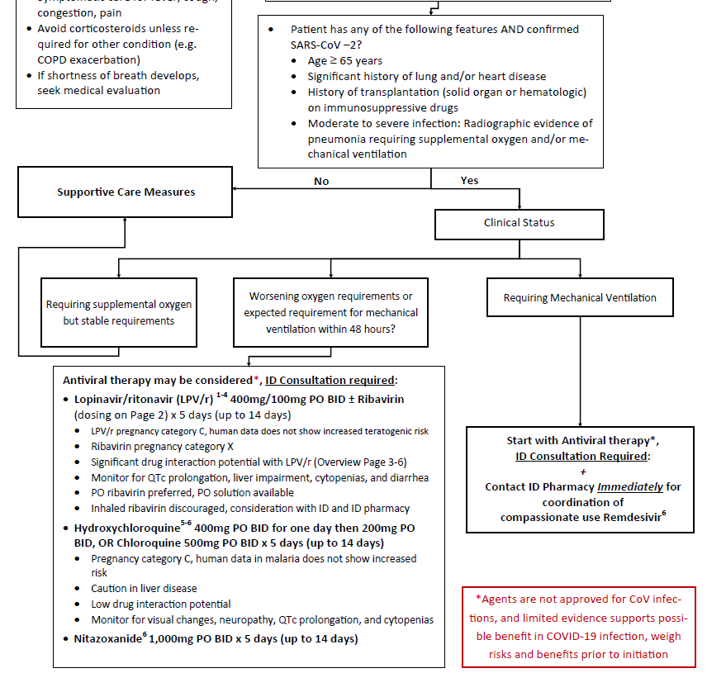
Proposed Management Algorithm
No approved or proven treatment of COVID-19 to date
Limited evidence may support trial of off-label agents with possible anti-viral activity (rapidly evolving, keep up to date)
Challenges – diagnostic delays, shortages, and low quality evidence to date

Slide 39
Pharmacist Involvement
Strategies to limit healthcare exposure of patients not suffering from COVID-19
Inventory control and resource conservation
Treatment pathway development and resource for critical evaluation of related evidence for novel therapies to manage COVID-19
Navigation of clinical trials/compassionate use of investigational therapies
Problem solving around supportive care measures

Slide 40
EIND Process
https://www.fda.gov/drugs/investigational-new-drug-ind-application/emergency-investigational-new-drug-eind-applications-antiviral-products
Step 1: contact company with investigational product to obtain approval for compassionate use
Step 2: contact FDA for approval to use investigational product
Step 3: if FDA approves, reach back out to company and coordinate with pharmacy and local IRB

Slide 41
Social Media and Misinformation

Slide 42
What is CPS doing?
Letter to the governor asking for emergency measures (sent March 13th)
Remote pharmacy practice – remove requirements for prior board approval
Allow 90 day supplies of chronic medications
Extend technician certification deadlines
Allow the CMO of CDPHE to allow pharmacists to provide designated services for:
Testing
Screening
Prescribing (standing order or CPA)

Slide 43
What is CPS doing?
Community forum for COVID-19
Childcare options for healthcare workers
Clinical trial information (post-COVID exposure prophylaxis)
Dedicated web page
Social media posts (follow us!)

Slide 44
National professional organizations
NACDS policy requests (partial list)
In anticipation of a COVID-19 vaccine, making sure pharmacists may access and immunize without barriers
Allowing pharmacists and techs to work across state lines
Broader prescriptive authority for mild ailments
Allowing remote verification of prescriptions
NASPA
Regular communication regarding activities in other states

Slide 45
Questions and Answers

