Slide 1
What the heck now?!?! Late Onset Cancer Treatment Toxicities
Jared M. Freml, Pharm.D., BCOP
June 26, 2020

Slide 2
Disclosure Statement – Financial Relationships to Disclose
Jared Freml
Statement of Disclosure
I have the following financial relationships:
      Company Name Affiliation
      AbbVie Spouse Employment/Shareholder
      I will discuss off-label mediation uses

Slide 3
Objectives
Recall late onset side effects associated with cytotoxic chemotherapy and oral cancer therapies
Explain the mechanisms of action of immune checkpoint inhibitors (ICI)
Describe late-onset toxicities associated with immune checkpoint inhibitors
Summarize management recommendations for immune checkpoint inhibitor toxicities

Slide 4
Audience Poll
How many in the audience regularly work with Oncology treatments?
  Rarely or not at all
  Sometimes in the outpatient setting
  Sometimes in the inpatient setting
  Regularly (i.e. daily/weekly)

Slide 5
US Cancer Statistics
Estimated New Cases in 2020: 1.8 million¹
  Men: Prostate, Lung, Colorectal, Bladder, Melanoma (skin)
  Women: Breast, Lung, Colorectal, Uterus, Thyroid
Estimated Deaths: 606,000¹
  Second to Heart Disease
2010-2016 5-year survival rate for all sites for cancer: 70.0%¹
  1950-54: 35%
During the past 20 years the FDA has approved over 150 drugs to treat Hem/Onc malignancies²
Seer Annual Report to the Nation 2020. https://seer.cancer.gov/report_to_nation/ Viewed on 4/18/20
Oncology Center of Excellence 2019 Annual report. https://www.fda.gov/media/134891/download. Viewed on 4/18/20

Slide 6
Cardiac Toxicities
Anthracyclines
Tyrosine kinase inhibitors/HER2 directed congestive heart failure
Cyclophosphamide - hemorrhagic carditits
5-Fluorouracil, capecitabine - ischemic changes
Interleukin-2 - myocardial depression
Taxanes, Cisplatin - sinus bradycardia
VEGF inhibitors – hypertension

Slide 7
Anthracycline Mechanism & Presentation
Anthracyclines reduced to free radicals
  Iron-anthracycline complexes initiate lipid peroxidation and cell destruction
  Damage mitochondrial membranes & disrupts energy production
The heart is at increased susceptibility
  Acute rhythm disturbances (benign)
  Subacute tachycardia, fatigue (weeks or months)
  Late-onset heart failure (5 to 20+ years)
Notes:
-

Slide 8
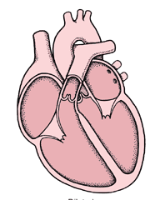
Risk Factors
Very young or old
Females > males
Pre-existing cardiac disease
Genetic predisposition
Dosing administration
  Bolus administration
  High cumulative doses
      Safe dose in children is lower
      Safe dose with radiation is lower
      Different cumulative doses with different anthracyclines
        Doxorubicin equivalents

Slide 9
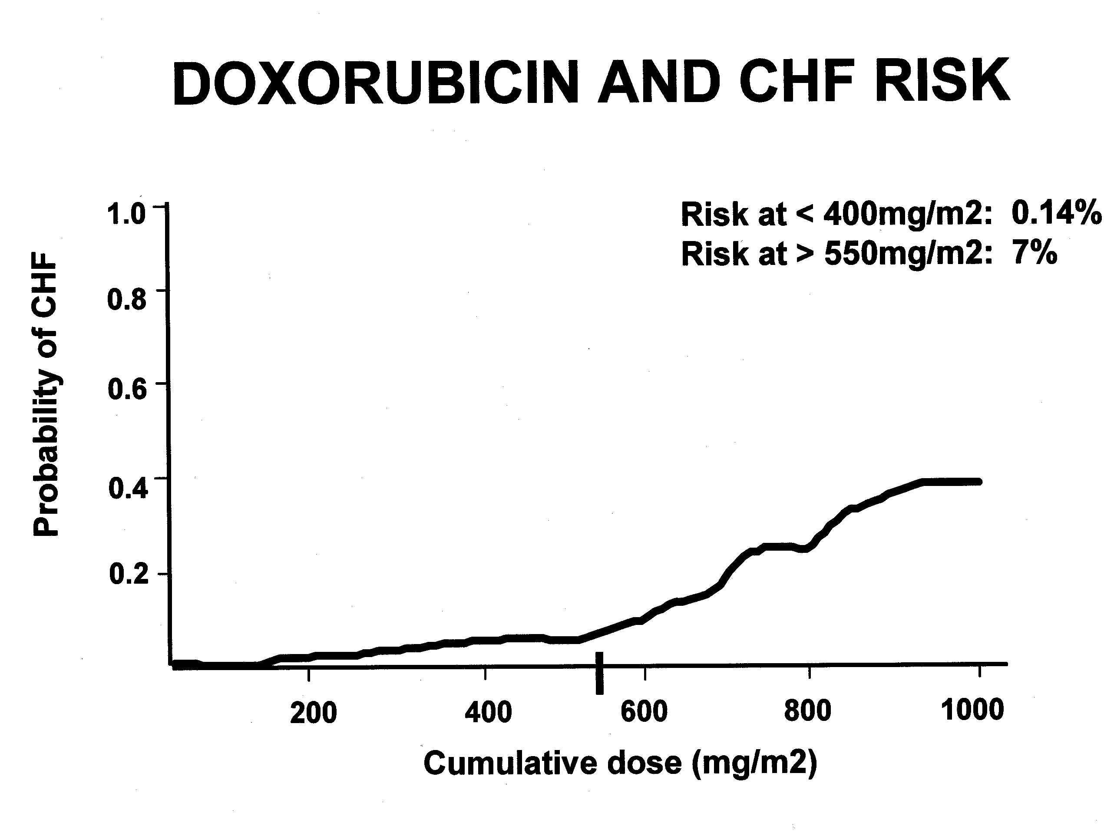
From: VonHoff D. Annals Internal Med, 1979

Slide 10
Cardiac Toxicity of HER2 Therapies
Trastuzumab, pertuzumab, laptinib, ado-trastuzumab emtansine, neratinib, fam-trastuzumab deruxtecan-nxki, tucatinib
Additive with anthracyclines
~3-4% increased risk
Risk factors:
  Radiation to left side
  DM
  CAD
  Valvular dysfunction
MOA: related to HER-2 receptors in cardiac tissue
Generally reversible

Slide 11
Cardiac Toxicity Prevention & Management
Thorough baseline assessment
Monitor LVEF
  Hold drug for <45-50% or if > 10% drop
Limit cumulative doses & avoid high peaks
Use less toxic analogs or liposomal products
May pretreat with dexrazoxane
  Limited clinical use due to potential to reduce antitumor effect
Medical Management
  Generally manage as other types of HF (e.g. ACE-I, B-blockers)

Slide 12
Treatment-Related MDS/AML
Heterogeneous hematologic malignancy characterized by clonal expansion of myeloid blasts in the peripheral blood
Approximately 21,450 patients were estimated to develop AML in 2019
  Reports suggest that 5-20% are therapy related
  More common in patients treated for breast cancer, gynecologic cancers, lymphoma
Disease course is generally progressive, resistant to standard therapies, with inferior outcomes
-National Cancer Institute. SEER cancer statistics. https://seer.cancer.gov/archive/csr/1975_2015/. Viewed on May 28, 2020.
-Pagana L, et al. Br J Haematol. 2001; 112:109-117

Slide 13
Treatments Associated with AML/MDS
Radiation
Topoisomerase Inhibitors (e.g. etoposide, doxorubicin)
Alkylating Agents (e.g. chlorambucil, cyclophosphamide)
Purine analog, fludarabine, especially when combined with alkylating agents
Poly(ADP-ribose) Polymerase (PARP) Inhibitors
Leone G, et al. Haematologica. 2007; 92:1389-1398

Slide 14
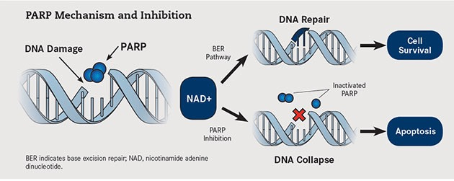
PARP Inhibitors
  Induction of synthetic lethality in tumor cells through the formation of double-stranded DNA breaks which cannot be accurately repaired, which leads to disruption of cellular homeostasis and cell death.
http://www.onclive.com

Slide 15
PARP Inhibitors
Ensure monthly monitoring during therapy and increase to weekly during times of cytopenias
  Bone marrow biopsy
MDS/AML 0.3-1.7%
MDS/AML onset generally ranges from 1 month to years later

Slide 16
Therapy-Related Bone Loss
Early breast cancer and non-metastatic prostate cancer survivors comprise the largest number of cancer survivors
Many treatments these patients are exposed to contribute to bone loss, especially in patients in their later decades of life

Slide 17
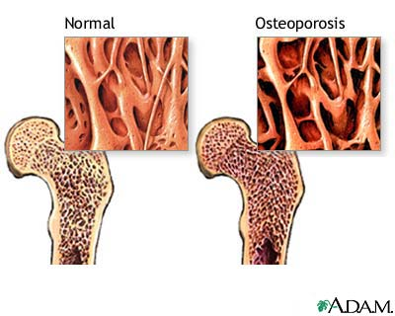
Mechanism
Decrease estrogen and testosterone production
  Modulation of effects on target tissues
Common agents
  Chemotherapy via premature menopause
  Aromatase Inhibitors
  Antiandrogens
  GnRH Agonists and Antagonist
  SERMs in premenopausal
  females

Slide 18
Risk Factors
Advanced Age (65 women; 70 men) | Smoking
Excessive Alcohol Consumption | History of Nontraumatic Fractures
Hypogonadism/therapies causing low sex hormones | Impaired Mobility
Increased risks for fall | Long-term Glucocorticoids (> 3 mo prednisone ≥2.5 mg/day )
Low Body Weight (< 58 kg) | Parental Hip Fracture
Postmenopausal status | Chronic Inflammation
Radiation

Slide 19
Screening/Monitoring Recommendations by ASCO Guidelines
Patients with one or more risk factor should be offered bone mineral density (BMD) testing with dual-energy x-ray absorptiometry (DXA)
Alternative methods considered when DXA unavailable
  Quantitative ultrasound or calcaneal DXA
Follow-up monitoring
  Q2 year monitoring: Patients on a cancer therapy causing bone loss with baseline or subsequent BMD is near threshold for therapy according to FRAX
  More frequent as clinically necessary (generally not more than annually)
Shapiro CL, et al. J Clin Oncol. 2019;37:2916-2946

Slide 20
Osteoporosis Management
Non-pharmacologic
  Diet with 1,000-1200 mg calcium and 800-1000 IU Vitamin D per day
  Exercise
  Minimize alcohol
  Smoking Cessation
Pharmacologic
  Oral Bisphosphonates
  IV Bisphosphonates
  Denosumab
  Avoid hormonal therapies for sensitive cancer types
Shapiro CL, et al. J Clin Oncol. 2019;37:2916-2946

Slide 21
Case 1
YS is a 60 yo female undergoing adjuvant hormone therapy with anastrozole to reduce the risk of ER+ breast cancer recurrence. The patient has been on therapy for about 4 months and during the follow-up visit with the Oncologist today complains of hot flashes and night sweats preventing a restful night of sleep. What is the best option for management?
Zolpidem 5 mg PO at bedtime as needed
Bioidentical estrogen/progestin cream
Venlafaxine 37.5 mg po daily
Black Cohosh 40 mg po bid

Slide 22
Hot Flashes
Approximately 50-80% men and women with prostate or breast cancer experience hot flashes
May result directly from drug’s mechanism of action or indirectly
  Aromatase Inhibitors- block enzymatic conversion of androgens to estrogens
  Chemotherapy/Radiation- may injure gonadal tissue resulting in reduced levels of sex hormone production
Notes:
-

Slide 23
Therapy Selection
Assess the cancer type
  Did the patient have a hormonally driven cancer?
  Does the patient have a genetic mutation that may lead to hormonally driven cancer?
If the answer is yes to either, generally avoid hormonal therapies

Slide 24
Hormonal (men) | Hormonal (women) | Non-Pharmacological
Testosterone | Estrogens +/- Progestins (intact uterus) | Acupuncture
Medroxyprogesterone | Tissue Selective Estrogen Complex | Exercise
Cyproterone acetate |  | Weight Loss (if needed)
Estrogens (e.g. diethylstilbestrol) |  | Hypnosis
 |  | Cognitive Behavioral Therapies
Just Say No to Herbals! Limited evidence showing effectiveness and these may contribute to toxicities and drug interactions (e.g. tamoxifen)

Slide 25
NCCN Survivorship Guideline V1.2020 https://www.nccn.org/professionals/physician_gls/pdf/survivorship.pdf. Viewed on 5.31.2020

Slide 26
Key Counseling Points
Set expectations
  How much this may reduce hot flashes
  When will this occur
Counsel on common adverse events and optimize dosing accordingly
Follow-up and adapt treatment
Notes:
-

Slide 27
Immune Checkpoint Inhibitor (ICI) Toxicities

Slide 28
Immune Therapies
Based on immunosurveillance: immune system’s ability to screen for, recognize and respond to foreign pathogens or abnormal cells
Phasic scenario
  Elimination-immunogenic tumor is eliminated
  Equilibrium- immune systems is unable to completely eliminate the tumor and remains present without progression or metastases
  Escape-following additional mutations
Not new, just rapidly expanding in recent years
  Better therapeutic index

Slide 29
Chae YK, et al. J ImmunoTher Cancer. 2018;6:39

Slide 30
Approved ICI Treatments [Approvals]
CTLA-4 | PD-1 | PD-L1
Ipilimumab (2011)[5]* | Nivolumab (2014)[11]* | Atezolizumab (2016)[6]
 | Pembrolizumab (2014)[23] | Avelumab (2017)[3]
 | Cemiplimab-rwlc (2018)[1] | Durvalumab (2017)[3]
*Ipilimumab and nivolumab are approved in some combinations
Notes:
-

Slide 31
Grading Cancer Therapy Toxicity
Management is generally driven by grading systems:
  https://ctep.cancer.gov/protocolDevelopment/electronic_applications/docs/CTCAE_v5_Quick_Reference_8.5x11.pdf
  Child-Pugh: https://www.merckmanuals.com/medical-calculators/ChildTurPuScore.htm
  Other specialty grading systems: ASTCT Consensus Grading for Cytokine Release Syndrome and Neurologic Toxicity Associated with Immune Effector Cells
Commonly found in prescribing information and tertiary drug references (LexiComp, Micromedex, etc)
Methods section primary publications and treatment protocols

Slide 32
Case 2
AV is a 56 yo male currently undergoing adjuvant therapy with pembrolizumab for melanoma. The patient has completed 3 months of therapy (planned 12 months). The patient had no prior lab abnormalities and was previously tolerating therapy well with only minor fatigue. During the patient’s pretreatment checkup the patient’s LFTs were noted to be abnormal as noted below:
  Total bilirubin 1.1 mg/dL (normal range 0.1-1.5 mg/dL)
  AST: 309 u/L (normal range 10-40)
  ALT: 1080 u/L (normal range 7-50)
  Alk Phos: 97u/L (normal range 20-123)
What Grade of Toxicity does the patient have and how do I manage them?

Slide 33
CTCAE
https://ctep.cancer.gov/protocolDevelopment/electronic_applications/docs/CTCAE_v5_Quick_Reference_8.5x11.pdf

Slide 34
Case 2: Stepwise Management
1. Determine how management guidelines direct dose adjustments and management
  Pembrolizumab liver toxicities classified by CTCAE
2. Apply toxicity assessment groups to situation at hand
  Bilirubin: normal range, Grade 0
  AST: 7.7 x ULN, Grade 3
  ALT: 21.6 x ULN, Grade 4
  Alk Phos: normal range, Grade 0
3. Manage the patient
  Use highest grade to direct therapy
    Stop pembrolizumab (permanently)
    Start high dose corticosteroids and monitor for response
    Counsel patient stopping therapy likely does not impair treatment outcome
  If other organ toxicities concurrently exist manage those at grade specific criteria

Slide 35
Immune Checkpoint Inhibitor Toxicities
Toxicities seen with immunotherapies are unique when compared to traditional therapy
  Onset-generally later
  Duration- generally longer
    Traditional chemotherapy- nausea and vomiting, alopecia, cytopenias
Many similarities are noted between autoimmune diseases and ICI toxicities
  Generally caused by alterations in genes encoding checkpoint proteins
  CTLA-4 and PD-1 polymorphisms have been linked to human autoimmune diseases like Celiac disease, diabetes mellitus, lupus rheumatoid arthritis and autoimmune thyroid disease
  Considerable overlap is noted between rheumatologic disease and ICI toxicity

Slide 36
CTLA-4 Toxicity Onset
Martins F, et al. Nature Reviews Clinical Oncol. 2019;16:563-580

Slide 37
PD-1/PD-L1 Toxicity Onset
Martins F, et al. Nature Reviews Clinical Oncol. 2019;16:563-580

Slide 38
CTLA-4 PD-1/PD-L1 Toxicity Onset
Martins F, et al. Nature Reviews Clinical Oncol. 2019;16:563-580
Notes:
-

Slide 39
Other Organs Impacted
Hematologic-anemia, thrombocytopenia
Musculoskeletal-myositis, arthralgia, myalgia, inflammatory arthritis
Neurologic-myasthenia gravis, Guillain-Barre syndrome encephalitis, aseptic meningitis, peripheral neuropathy
Cardiac-myocarditis, pericarditis, conduction abnormalities, impaired ventricular function
Eye-uveitis, episcleritis

Slide 40
General Management
ICI toxicity can occur at any time
Refer to CTCAE grading and prescribing information
ALWAYS Consult Oncology and comanage high grade toxicities with subspecialists
Moderate(Grade 2) to high grade(Grade 3/4) toxicity managed with corticosteroids (prednisone 1-2 mg/kg) as primary therapy
  Notable exceptions: DM/DKA, thyroid dysfunction, fatigue
Notes:
-

Slide 41
General Management
Toxicity specific therapy escalation if no improvement by 24-72 hours
  E.g. infliximab-colitis; mycophenolate-hepatitis, pneumonitis; vedolizumab-colitis
Taper begins when toxicity resolves, NOT at the time of treatment initiation
  SLOW, SLOW, SLOW!!!
  No need to rush back to treatment, therapeutic effect likely still present
  Rechallenge may = recurrent toxicity
Supportive care meds for corticosteroid taper ADRs

Slide 42
Supportive Care Medications
Infectious Prophylaxis
  Pneumocystis jiroveci pneumonia (PJP):
    Prednisone equivalent ≥ 20mg x 4 or more weeks
  Fungal:
    Prednisone equivalent ≥ 20mg x 6 or more weeks
  Viral
GI Prophylaxis
Osteoporosis
Insomnia

Slide 43
Useful Guidelines for ICI toxicities
NCCN-Management of Immunotherapy-Related Toxicities
ESMO-Management of toxicities from immunotherapy: ESMO Clinical Practice Guidelines for diagnosis, treatment and follow-up
ASCO-Management of Immune-Related Adverse Events in Patients Treated with Immune Checkpoint Inhibitor Therapy: ASCO Clinical Practice Guideline
  Summary table: https://www.asco.org/sites/new-www.asco.org/files/content-files/practice-and-guidelines/2018-management-of-irAEs-summary.pdf
ASTCT Consensus Grading for Cytokine Release Syndrome and Neurologic Toxicity Associated with Immune Effector Cells
Notes:
-

Slide 44
Summary
Toxicities seen with cancer therapies vary widely and are becoming more complex every day as cytotoxic, tyrosine kinase inhibitors and immune based therapies are combined
CTCAE/prescribing information/primary literature methods are good sources to focus management approach
Major Oncology guidelines are helpful references
Loop in Oncologist and Oncology Pharmacist to help with management recommendations

Slide 45
Questions?
Email: jared.m.freml@kp.org

